Slide 1
Red Queen Hypothesis

Slide 2
Hypothesis
Coevolution
between
Host and Parasite
maintain genetic variation

Slide 3
Game

Slide 4
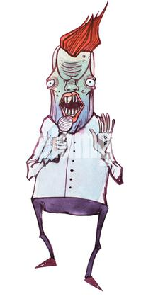
Parasite Host
Vs

Slide 5
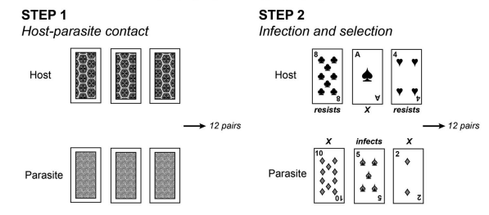
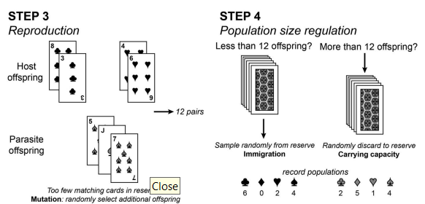

Slide 6
If no one genotype can take over
Variation is maintained

Slide 7
Co-evolution is rapid
Most fit now may soon become least fit
If rare genotype have an advantage, genetic variation will be maintained through time

Slide 8
Link for the game video
https://www.youtube.com/watch?v=fFdGn1FQB0E
Link for research paper
https://evolution-outreach.biomedcentral.com/articles/10.1186/s12052-015-0039-2

