Slide 1

In tropical woods, where green is deep,
Janzen-Connell’s promises to keep.
Ants stand guard, protectors in the night,
While acacias offer refuge, a haven so bright.
A dance of survival, a poet's delight,
In this woodland sonnet, written in light.
Each partner dependent, a shared destiny,
Ants and acacias, in harmonious symphony.
It's just not two actors, it is not that narrow,
It's all the life connecting in the barrow

Slide 2
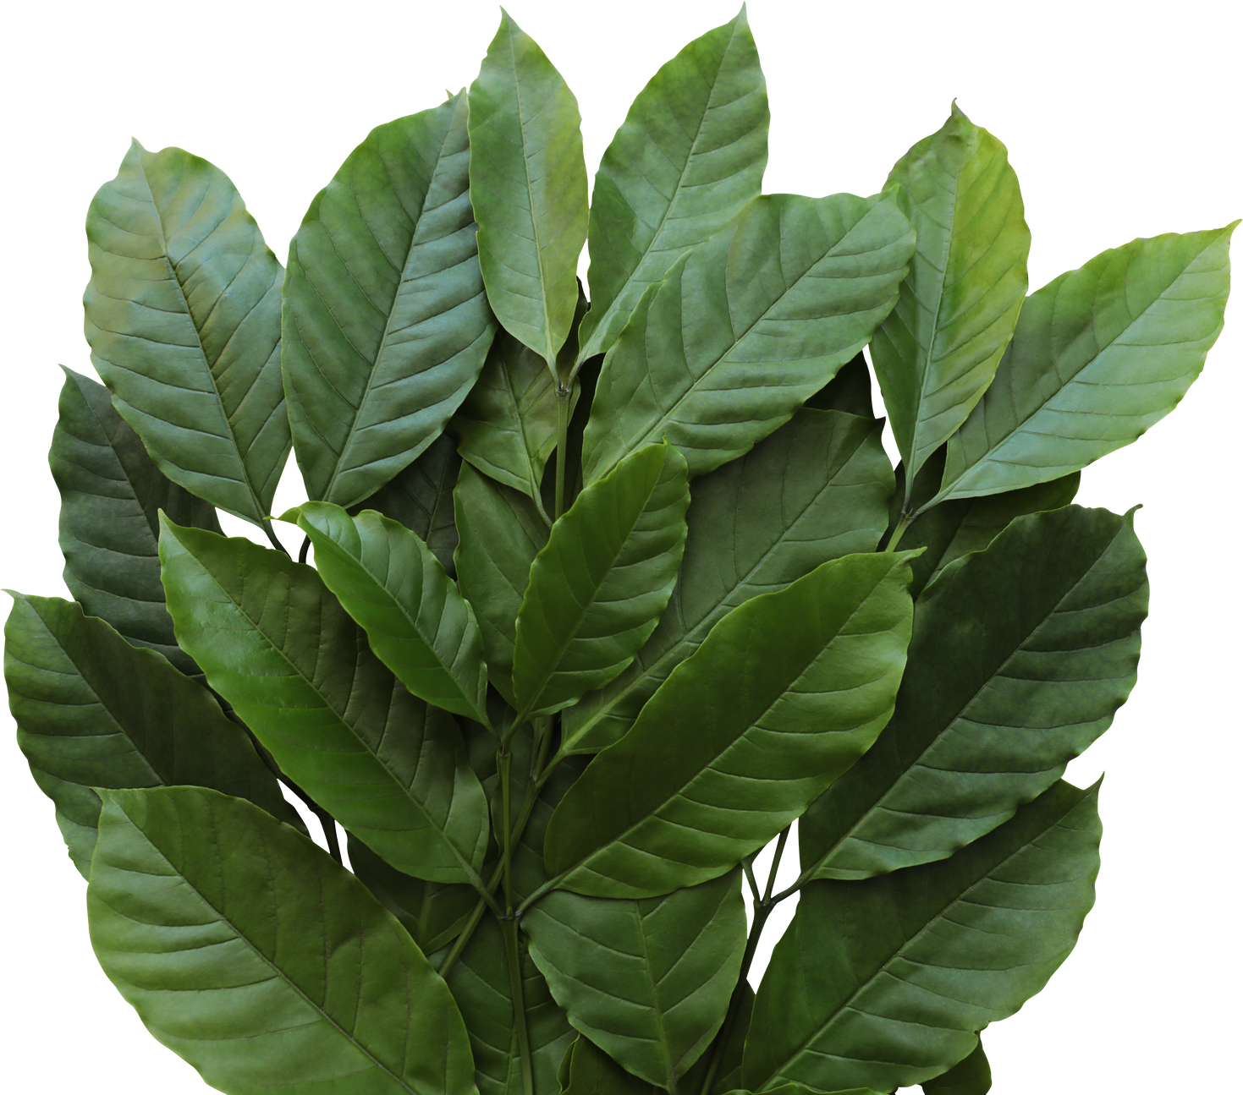
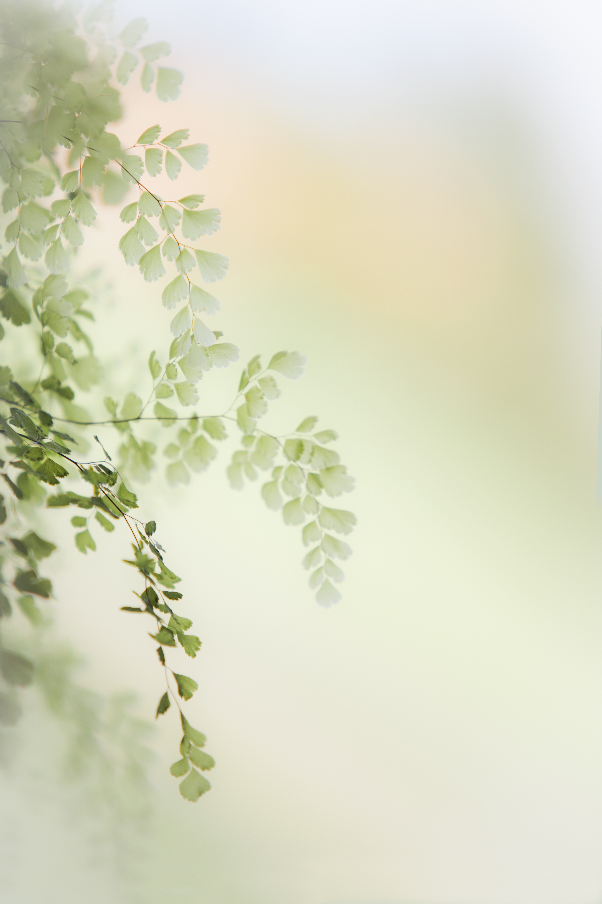
The ants, like sentinels, in shadows they roam,
Guardians of Acacias, a woodland home.
Against herbivores, they stand the line,
In the verse of nature, a tale divine.
Herbivores retreat, as ants declare,
A pact with Acacias, a bond so rare.
Through the forest's veins, a network flows,
Biodiversity thrives, and nature bestows.
In the echo of their pact, the ecosystem thrives,
A promise, where every life derives.
Mutually responsible, a dance sublime,
In Janzen-Connell's rhythm, the forest's prime.
Diksha 2023MSCES03

