Slide 1
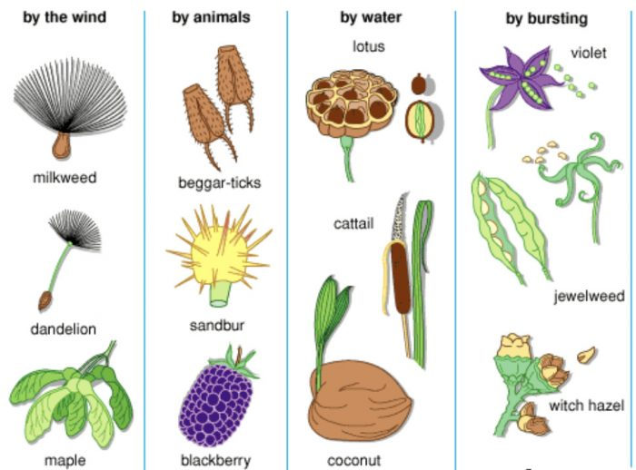
Seed Dispersal - ಬೀಜ ಪ್ರಸರಣ Directed dispersal hypothesis

Slide 2
Introduction
Target Audience: Govt. school students of Karnataka.
Directed dispersal hypothesis was given by Howe & Smallwood (1982).
App used: Ibis paint x.
5 types of seed dispersal mechanism: Gravity, Water, Ballistic, Wind and Animals.
Why Visual Representation?

Slide 3
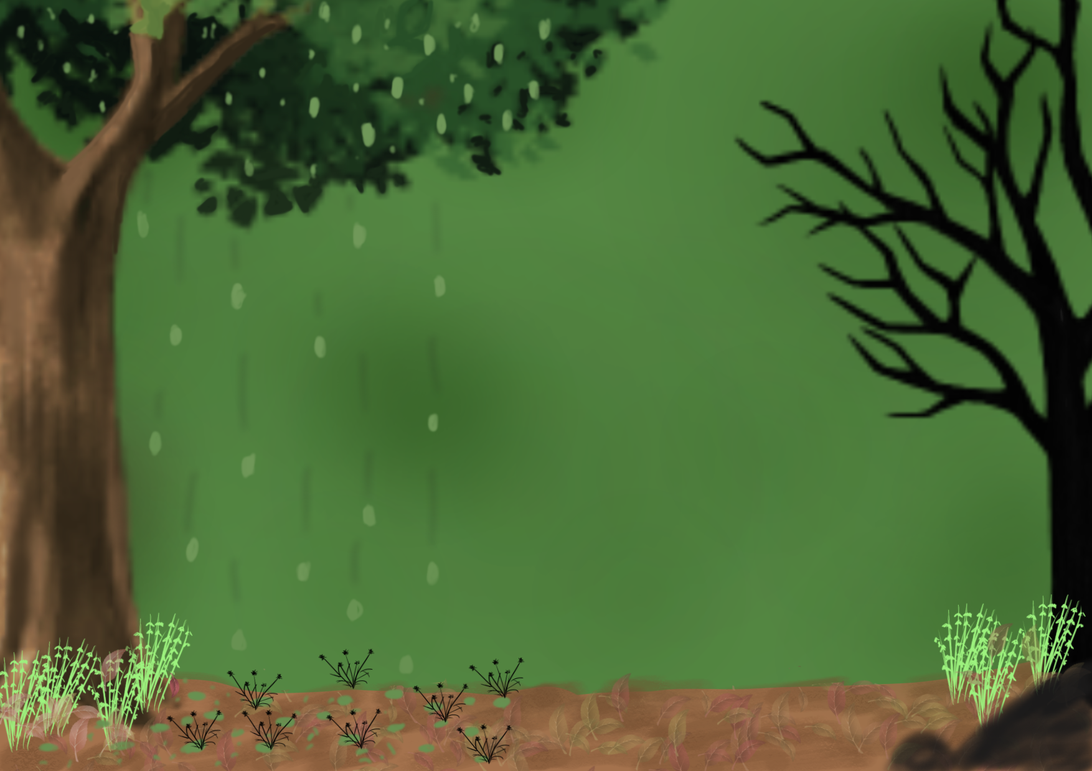
Gravity ಗುರುತ್ವಾಕರ್ಷಣೆ

Slide 4
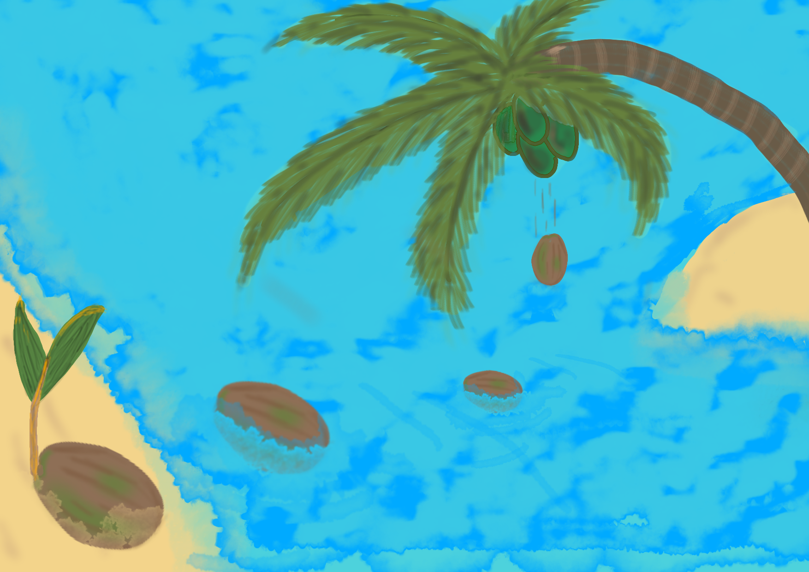
Water ನೀರು

Slide 5
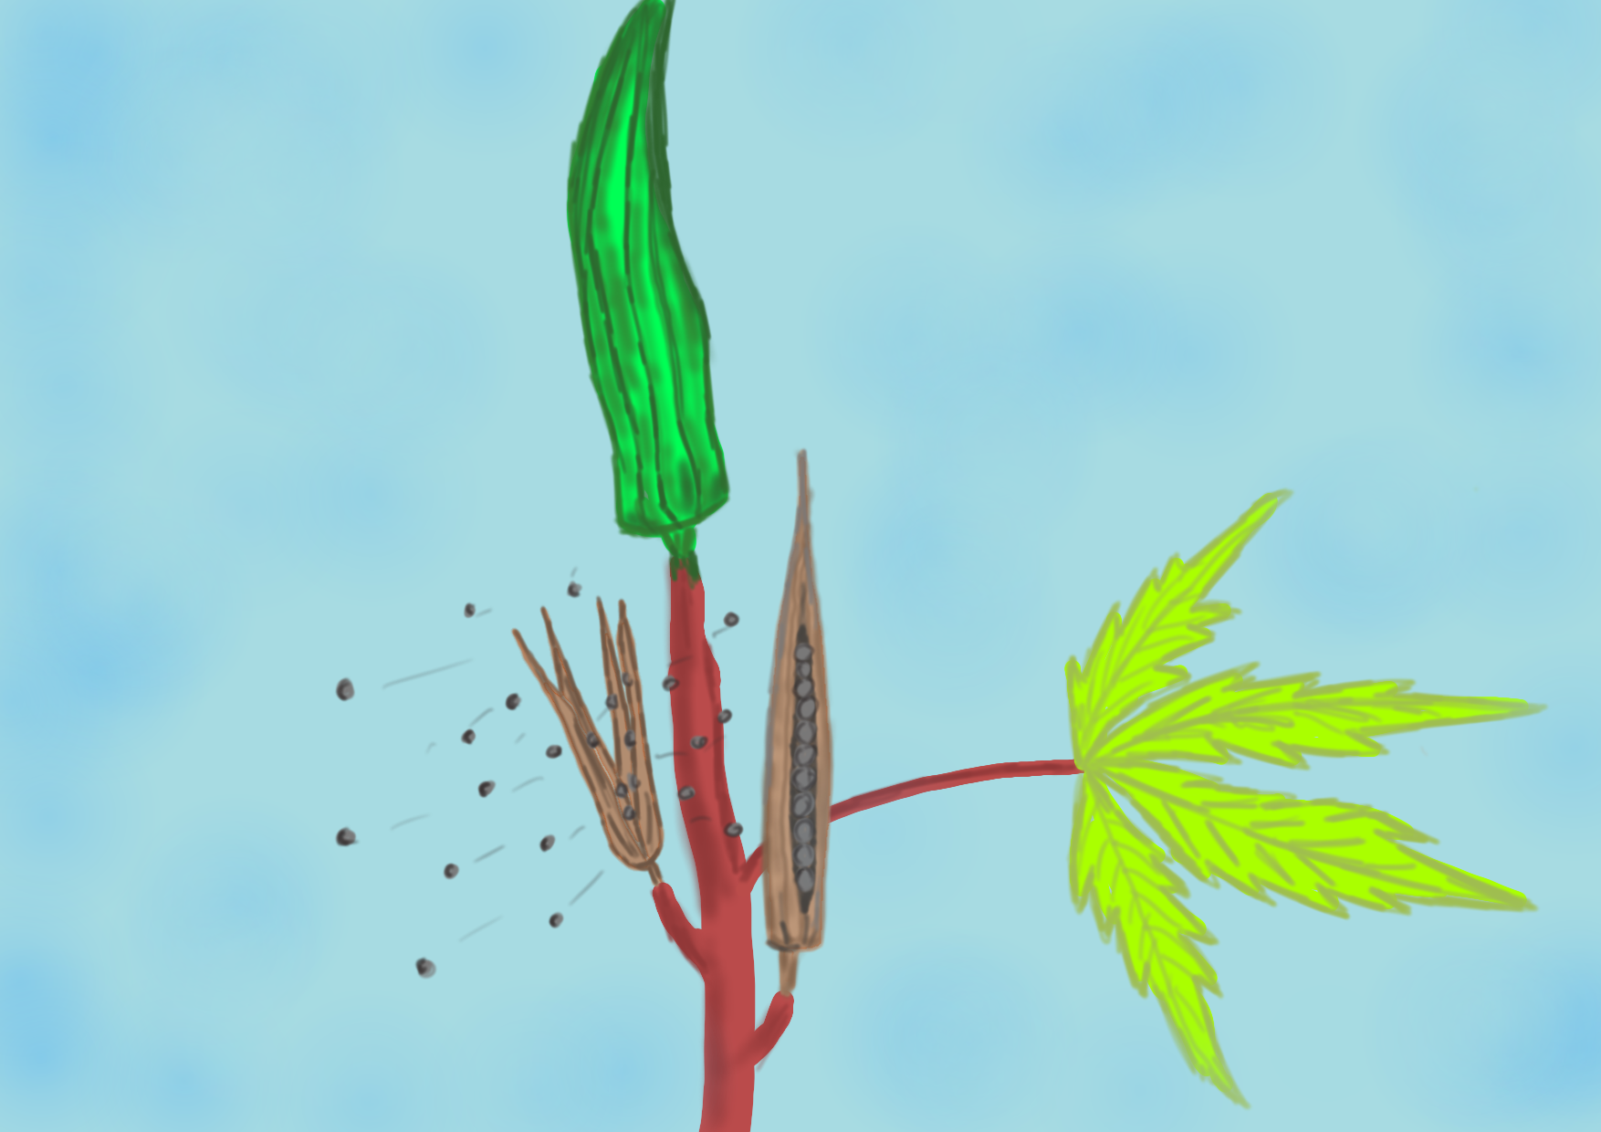
Ballistic ಸ್ಫೋಟ

Slide 6
Wind ಗಾಳಿ

Slide 7
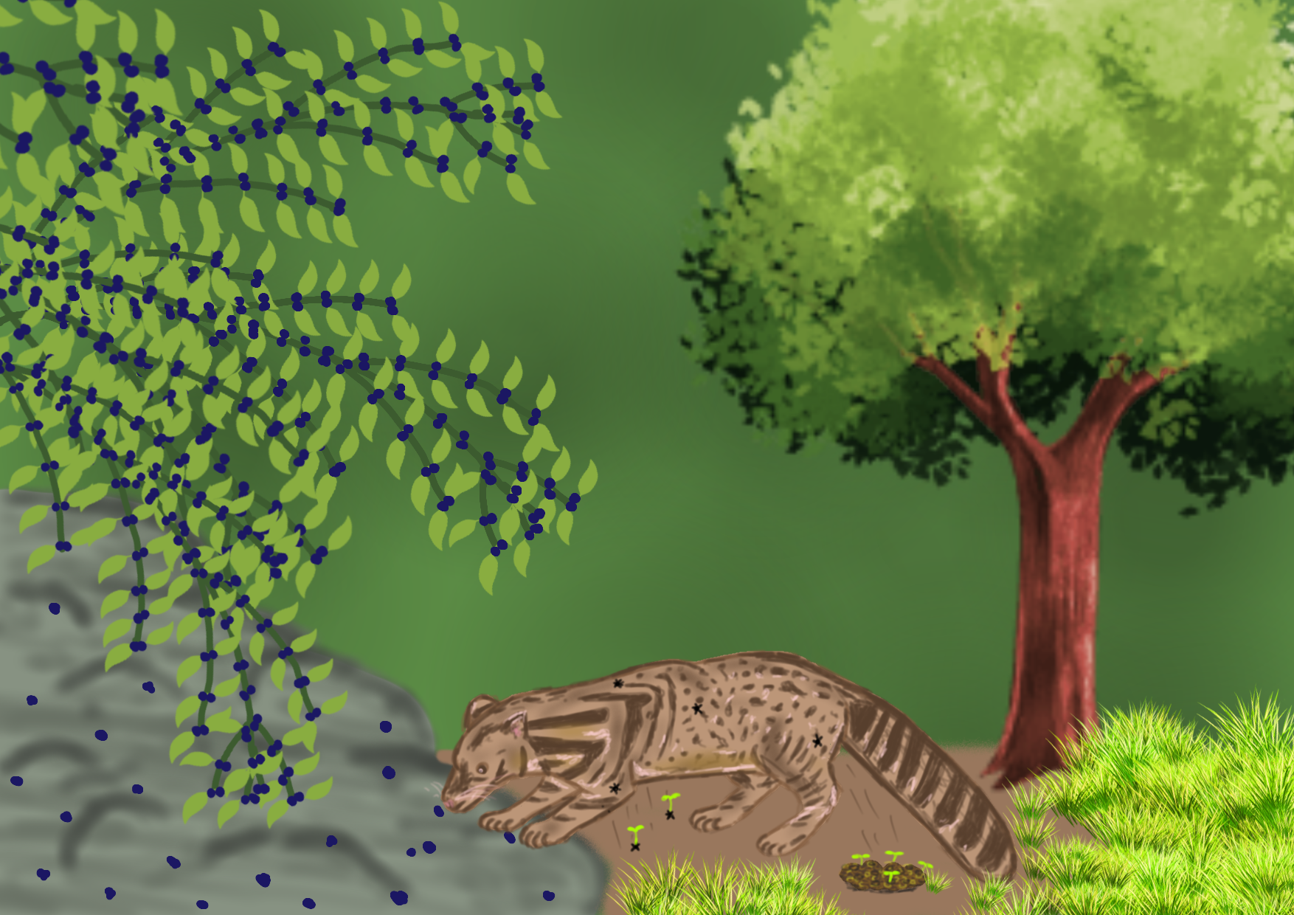
Animals ಪ್ರಾಣಿಗಳು

Slide 8
References
Howe, H F; Smallwood, J (November 1982). "Ecology of Seed Dispersal". Annual Review of Ecology and Systematics. 13 (1): 201–228.
Green, Andy J.; Baltzinger, Christophe; Lovas-Kiss, Ádám (2021-06-24). "Plant dispersal syndromes are unreliable, especially for predicting zoochory and long-distance dispersal". Oikos. 2022 (2).
Bullock, James M.; Shea, Katriona; Skarpaas, Olav (2006-10-01). "Measuring plant dispersal: an introduction to field methods and experimental design". Plant Ecology. 186 (2): 217–234.
Harms, K; Wright, SJ; Calderon, O; Hernandez, A; Herre, EA (2000). "Pervasive density-dependent recruitment enhances seedling diversity in a tropical forest". Nature. 404 (6777): 493–495.
Wenny, D.G. & Levey, D.J. (1998). ”Directed seed dispersal by bellbirds in a tropical cloud forest". Proceedings of the National Academy of Sciences of the United States of America. 95 (11): 6204.

Slide 9
Thank You
Presented by
Kishore Raj D

