Slide 1
Can you guess convergence?
A game by Maitrey D.
MSc Conservation

Slide 2
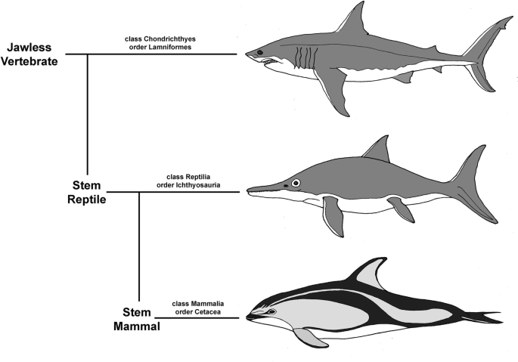
Convergent Evolution
“Where two different groups of organisms accidentally show up at life’s party in the same outfits.” - Ed Yong
It is an evolutionary process where unrelated organisms have evolved structures, or traits, that have the same ecological or behavioral function.
This game is meant to teach about how natural selection can come with surprisingly similar results, given enough time.

Slide 3
Divergent or parallel evolution
Homology
Parallelism
Convergence
ancestor that had the same feature
ancestor that had the initial feature, that led to later similarity
more distant common ancestor

Slide 4
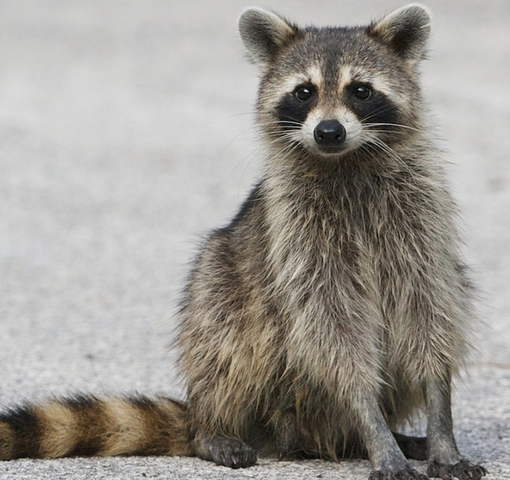
How to play the game
There are two formats.
Click the or button
whenever they are present.
YES
NO
If there are 3 options, 2 cases are parallelly evolved, and one is a case of convergence. Pick that one.
Make sure to click the shaded portion of the button.
B

Slide 5
Welcome to the Greatest Show on Earth!

Slide 6
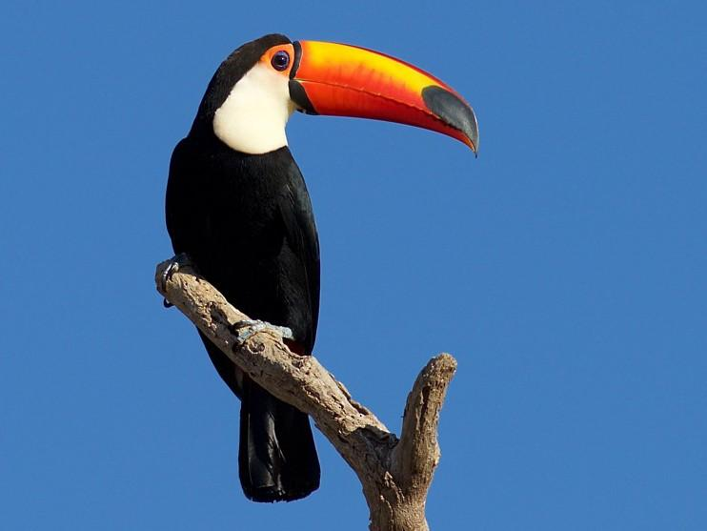
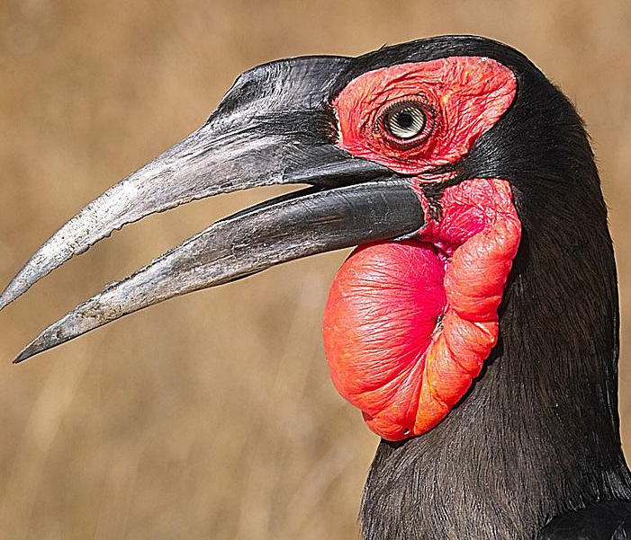
Which is a case for convergence?
A
B
C

Slide 7
Which is a case for convergence?
Toco Toucan
(Americas)
Ground hornbill
Wreathed hornbill
CORRECT!
B
C
Africa
Asia
Next Q
A

Slide 8
Which is a case for convergence?
A
B
C
Go Back

Slide 9
Which is a case for convergence?
A
B
C
Go Back

Slide 10
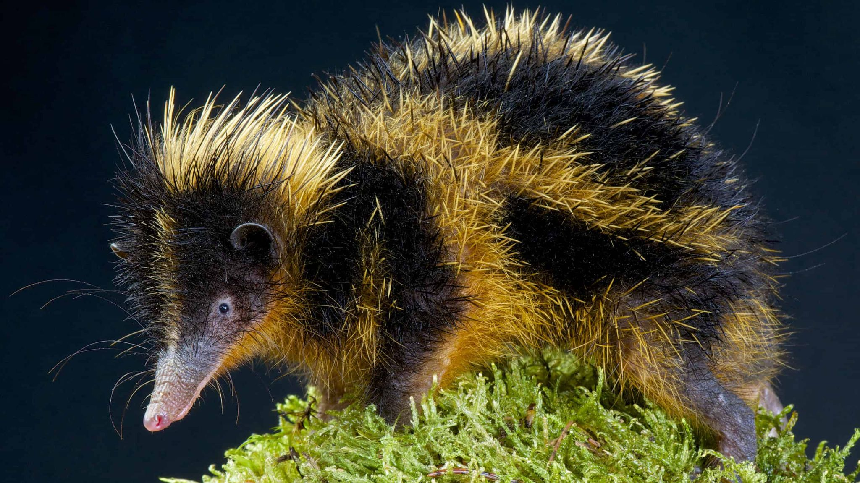
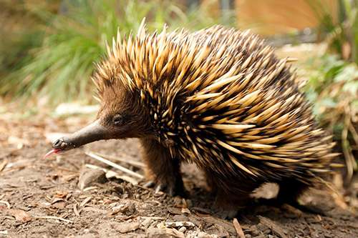
Is this a case of convergence?
YES
NO
Found in Madagascar
Found in New Zealand

Slide 11
It is convergent evolution!
Both these animals are insectivores, and their taxonomic history is equally convergently convoluted.
YES!
Streaked tenrec
Lowland echidna
It is a monotreme, an egg laying mammal.
It is related to other Afrotheres, including elephants.
Found in Madagascar
Found in New Zealand

Slide 12
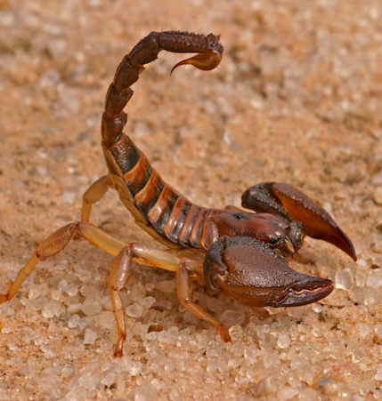
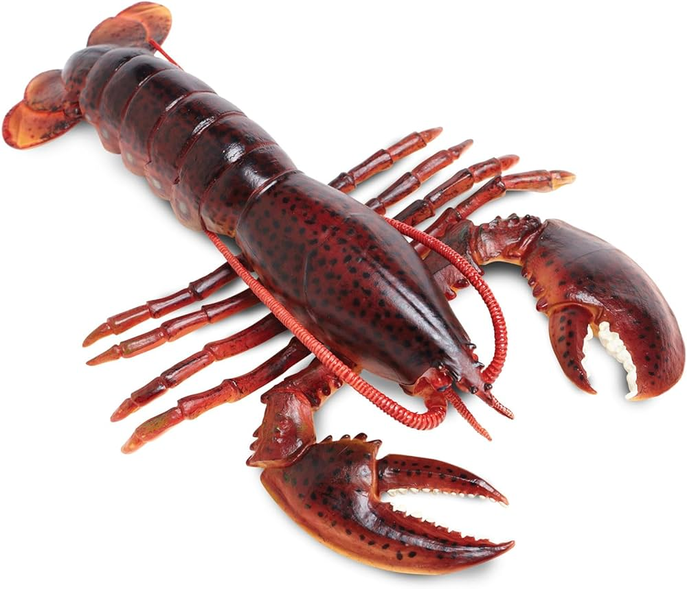
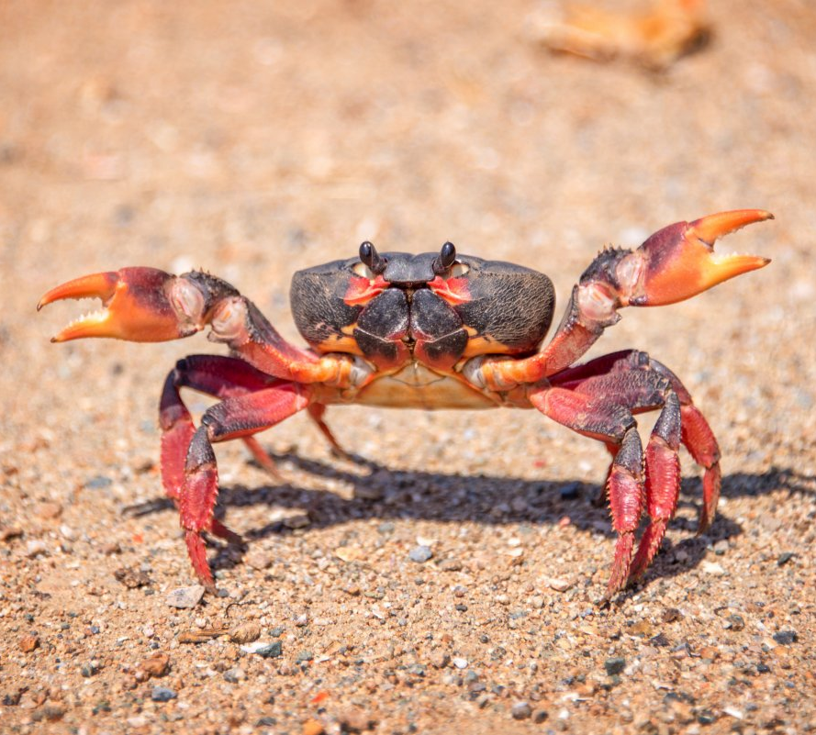
Which is a case for convergence?
A
B
C

Slide 13
Which is a case for convergence?
Scorpion
(It is an arthropod, 6 limbs)
Lobster
Crab
CORRECT!
B
C
Both are crustaceans, and decapods.
A
Next Q

Slide 14
Which is a case for convergence?
A
B
C
Go Back

Slide 15
Which is a case for convergence?
A
B
C
Go Back

Slide 16
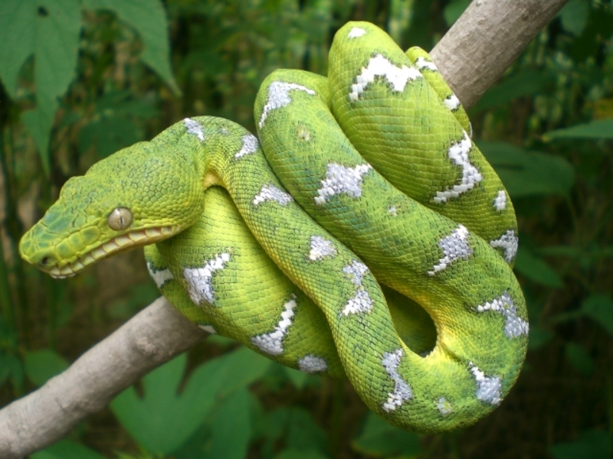
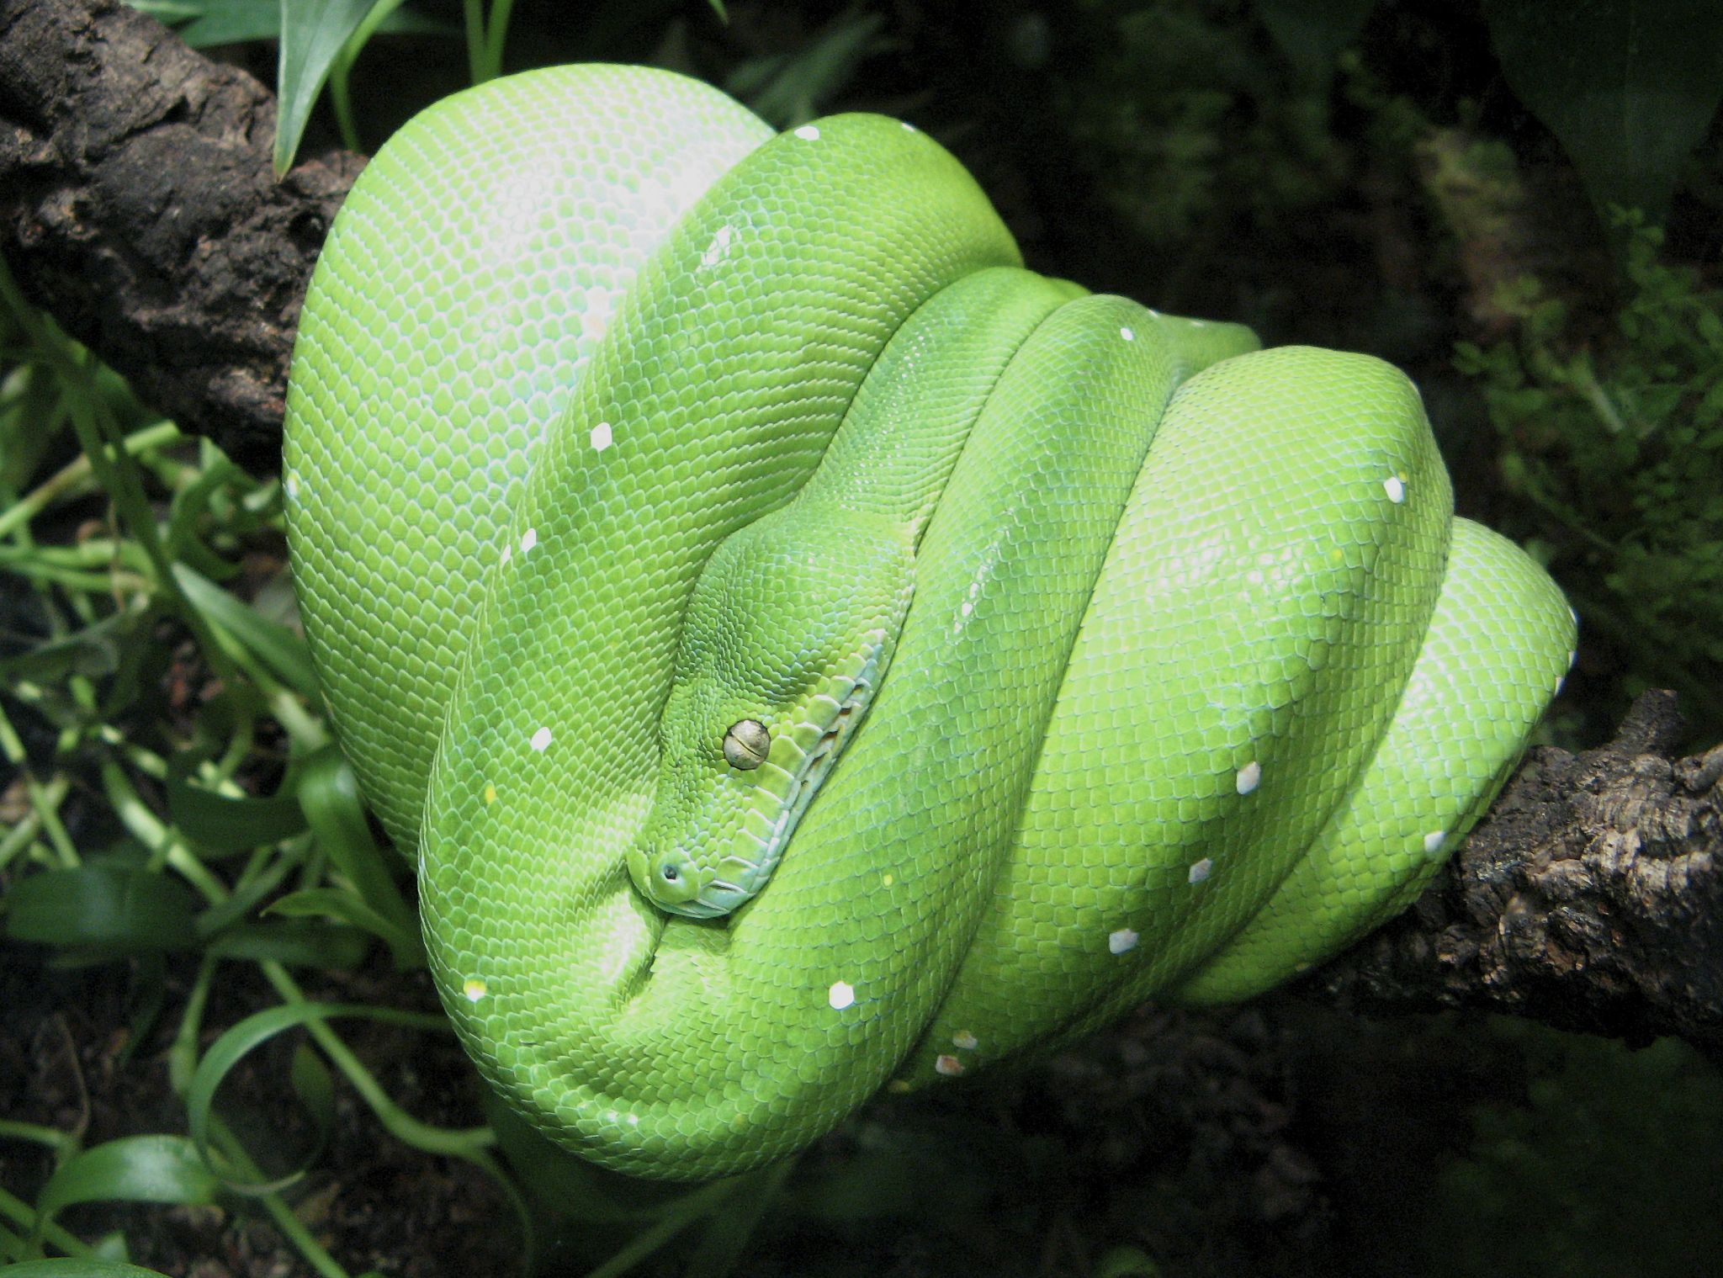
Is this a case of convergence?
YES
NO
Found in South America
Found in Indonesia

Slide 17
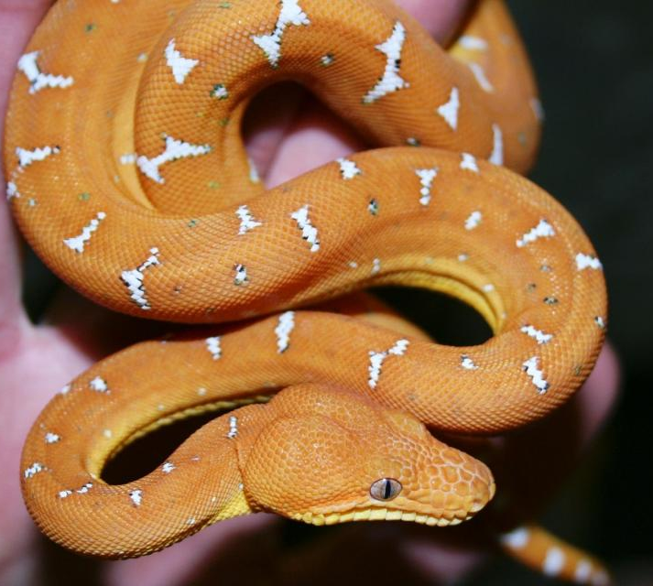
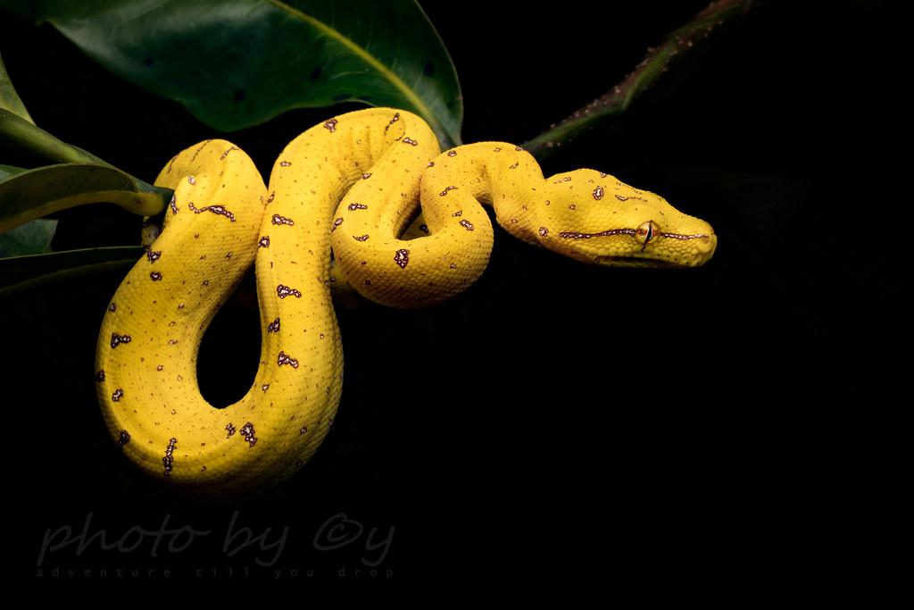
It is convergent evolution!
Even the juveniles are strikingly convergently coloured!
Emerald tree boa
YES!
Green tree python
Found in South America
Found in Indonesia

Slide 18
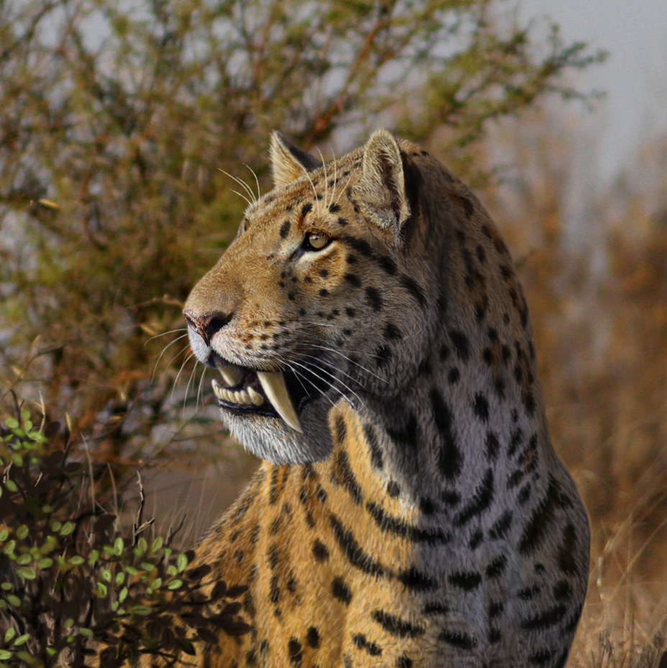
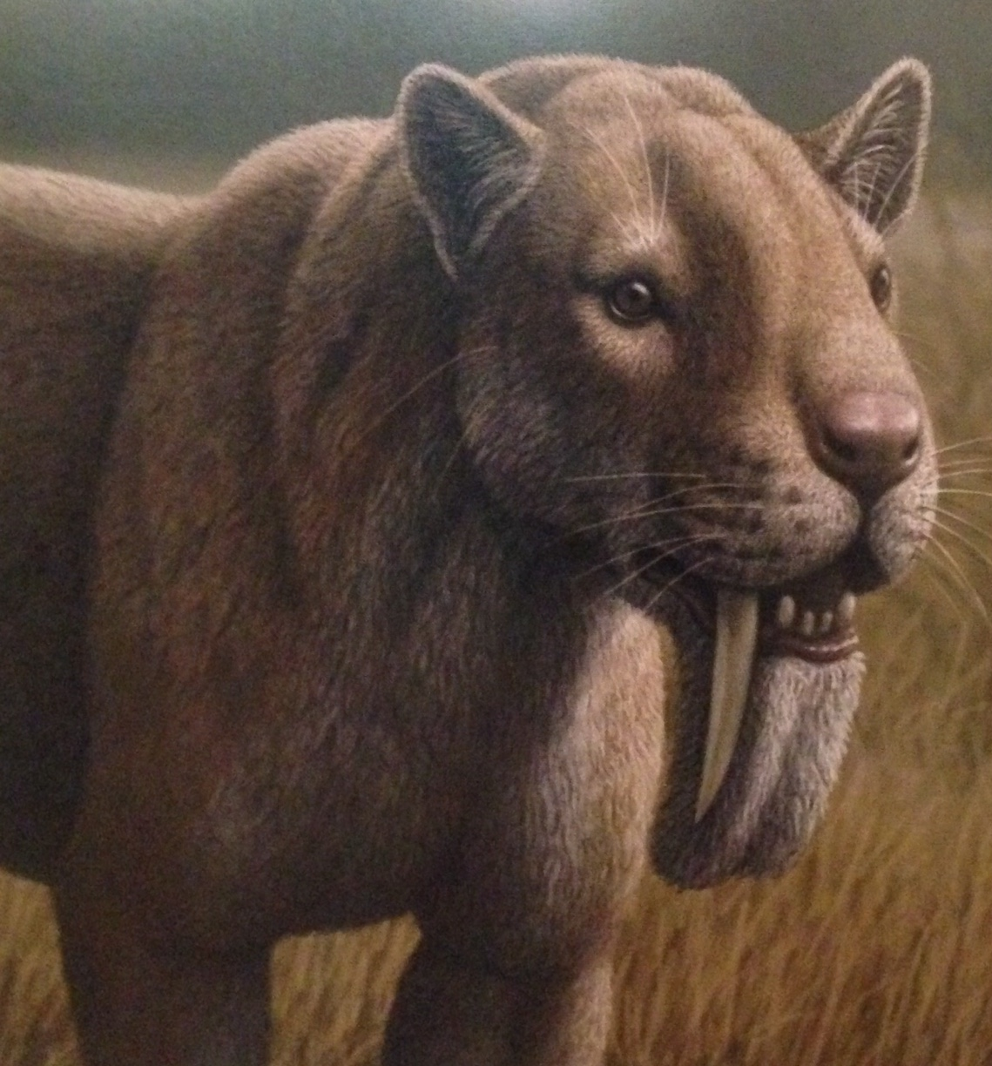
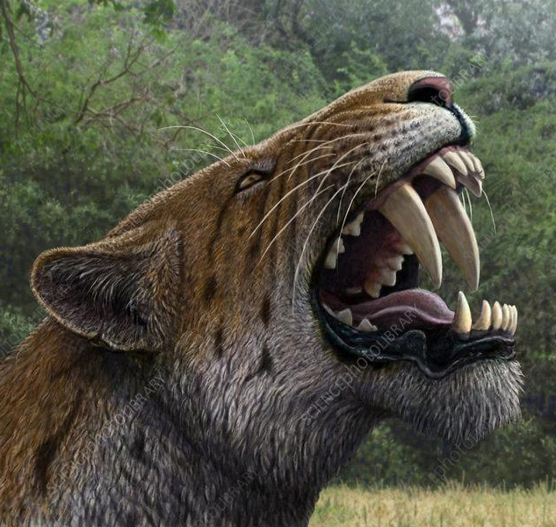
Which is a case for convergence?
A
B
C

Slide 19
Which is a case for convergence?
Both are cats, of the meowing kind.
Smilodon
Homotherium
Thylacosmilus
(It is a marsupial)
CORRECT!
A
B
Next Q
C

Slide 20
Which is a case for convergence?
A
B
C
Go Back

Slide 21
Which is a case for convergence?
A
B
C
Go Back

Slide 22
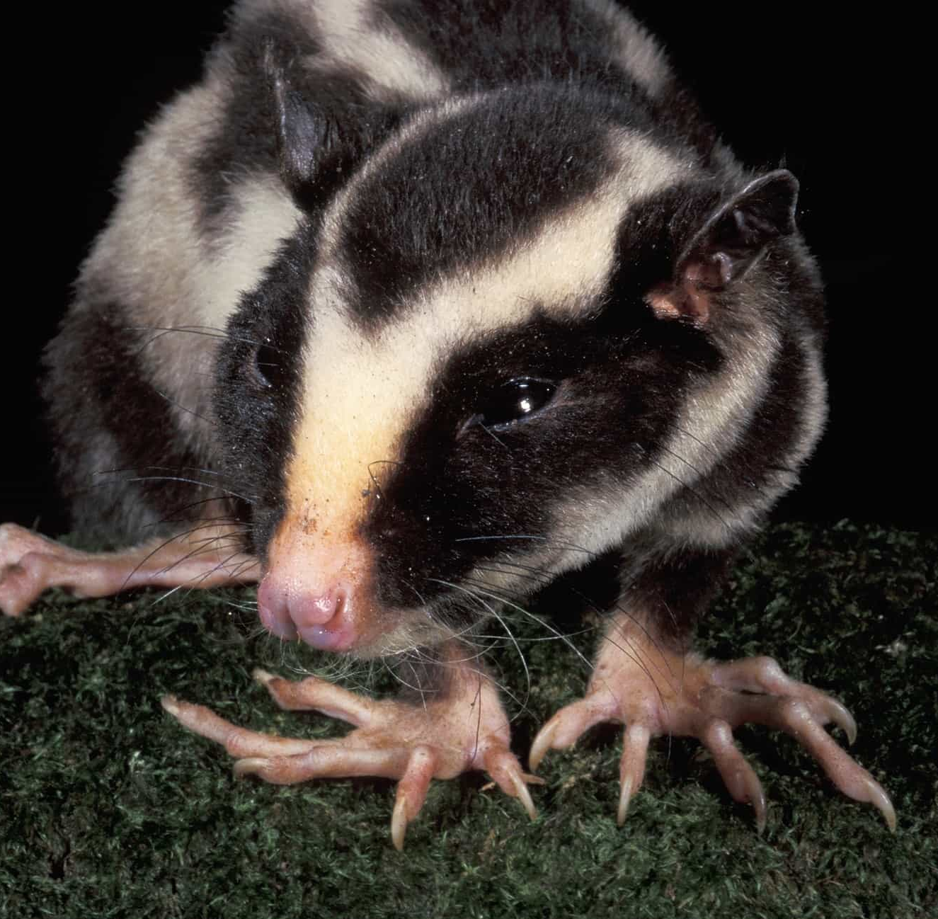
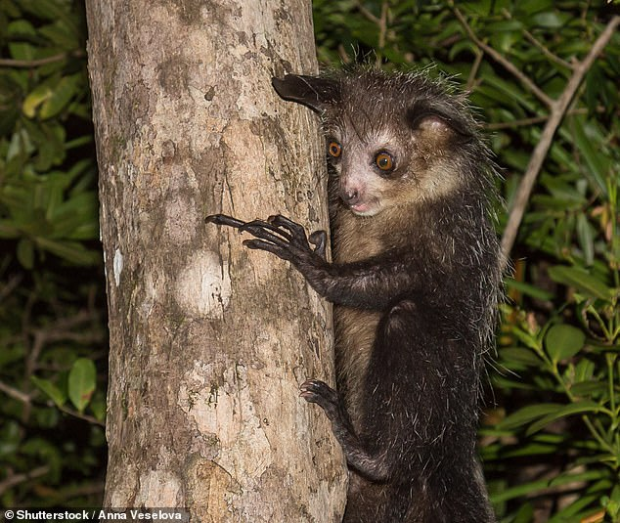
Is this a case of convergence?
YES
NO
Found in New Guinea
Found in Madagascar

Slide 23
It is convergent evolution!
Both these animals fill the woodpecker niche in their islands.
Striped possum
YES!
Aye aye
It is a marsupial.
It is lemur.
Found in New Guinea
Found in Madagascar

Slide 24
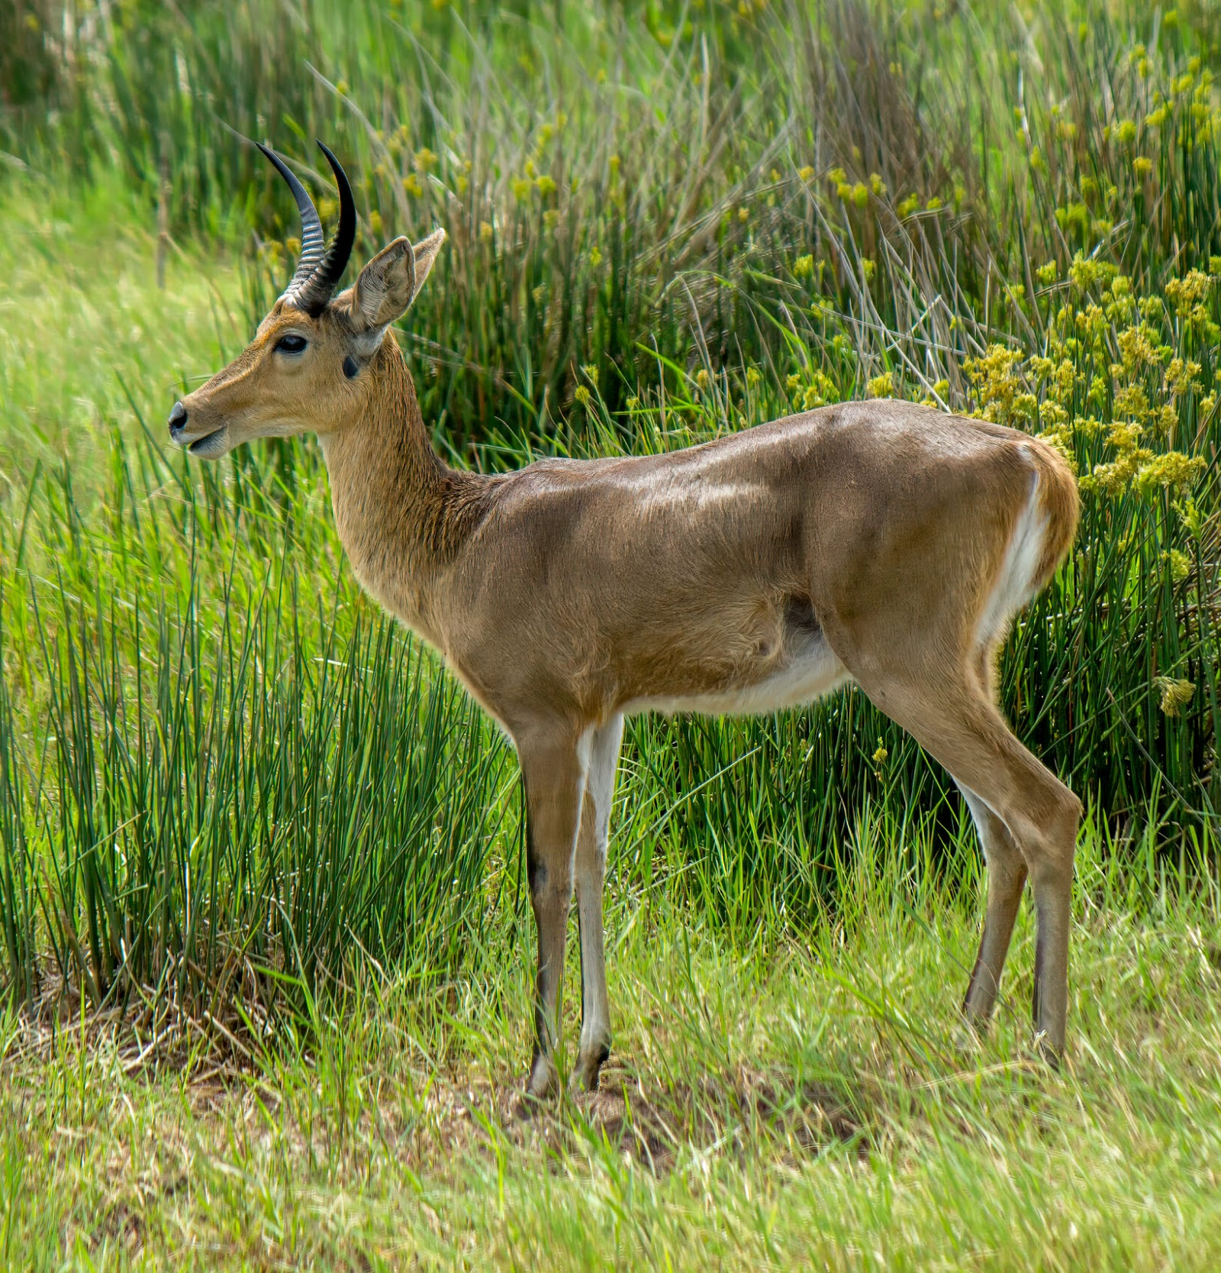
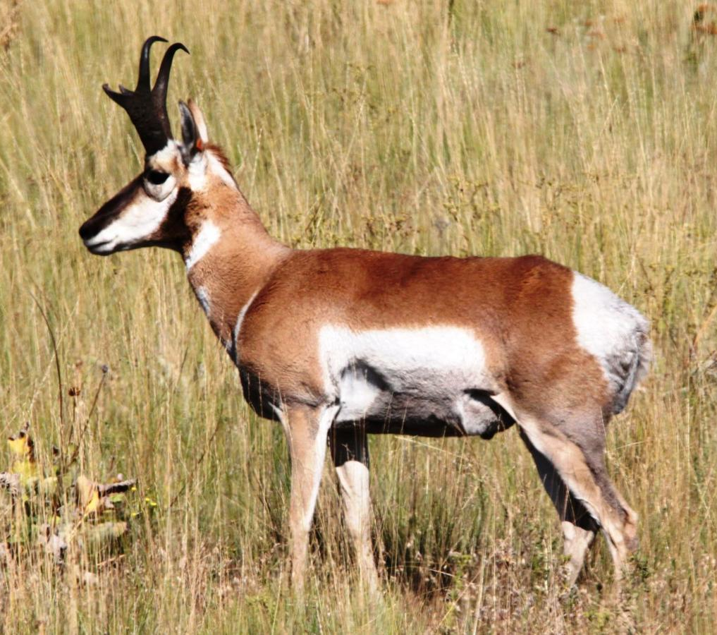
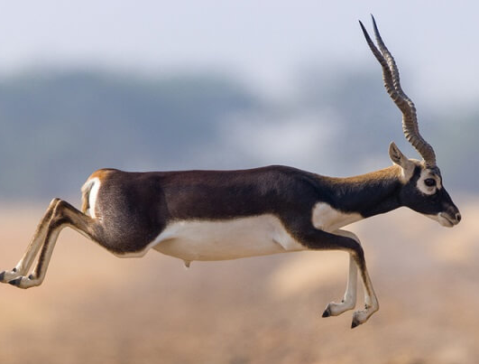
Which is a case for convergence?
North America
Africa
Asia
A
B
C

Slide 25
Which is a case for convergence?
Blackbuck
Reedbuck
Pronghorn
(only called an antelope by Americans)
CORRECT!
A
C
Actually an antelope
Actually an antelope
B
Next Q

Slide 26
Which is a case for convergence?
A
B
C
Go Back

Slide 27
Which is a case for convergence?
A
B
C
Go Back

Slide 28
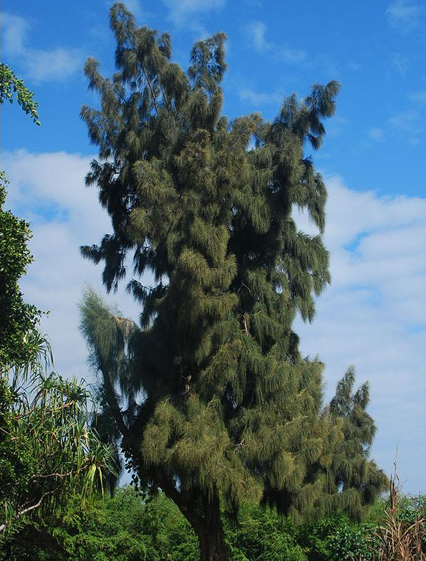
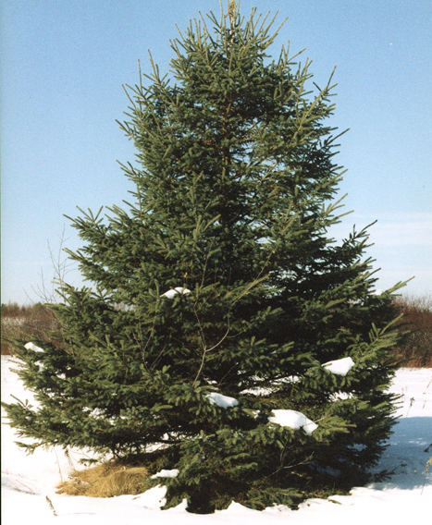
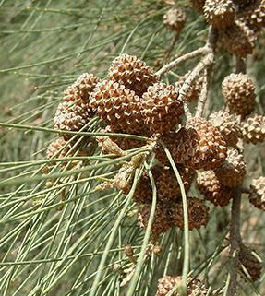
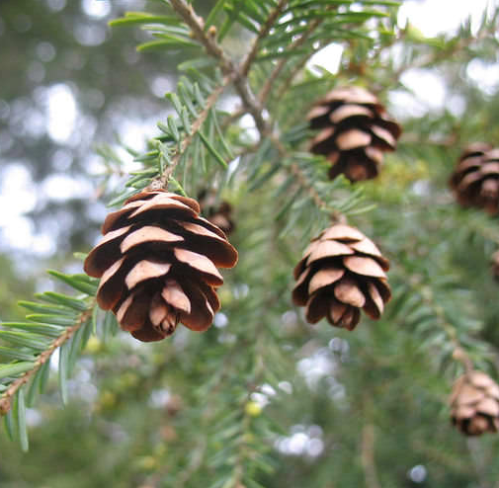
Is this a case of convergence?
YES
NO
Found in Australasia and East Africa
Found in northern Eurasia

Slide 29
It is convergent evolution!
YES!
Casuarina sp.
White spruce
It is flowering plant, an angiosperm.
It is a gymnosperm, belonging with pines and cedars.
Found in Australasia and East Africa
Found in northern Eurasia

Slide 30
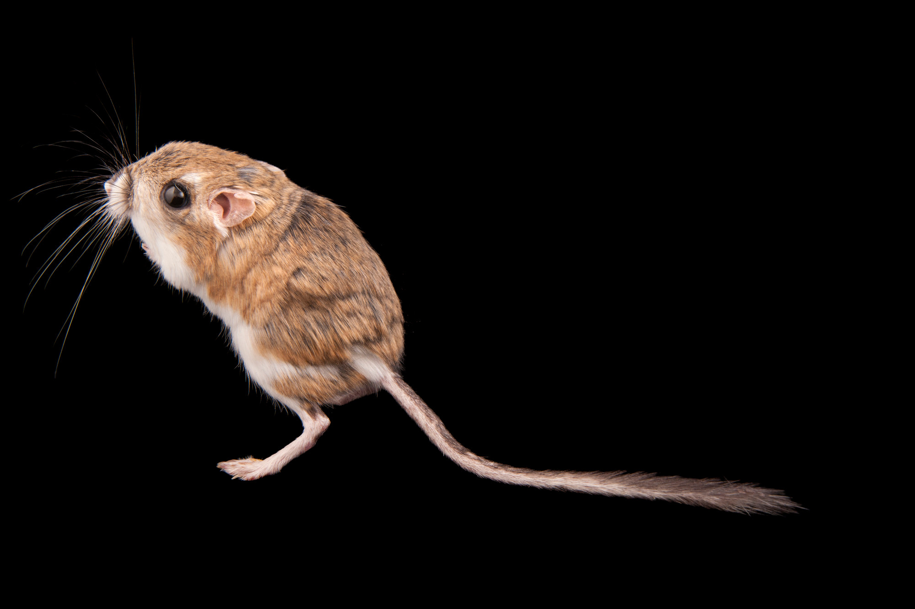
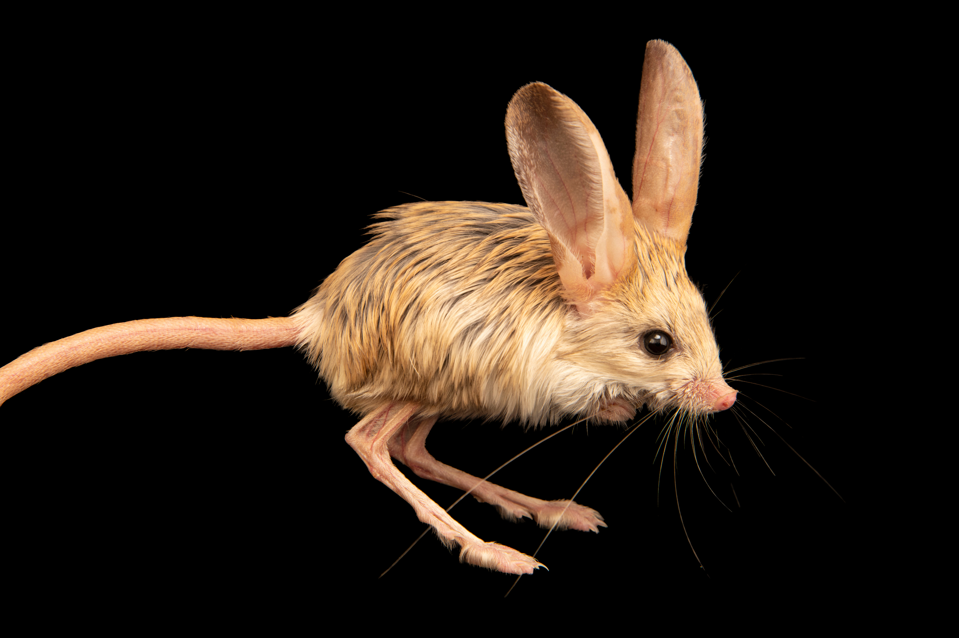
Is this a case of convergence?
Bonus: Which is named after the Kangaroo?
YES
NO
Found in North America
Found in north Africa and West Asia

Slide 31
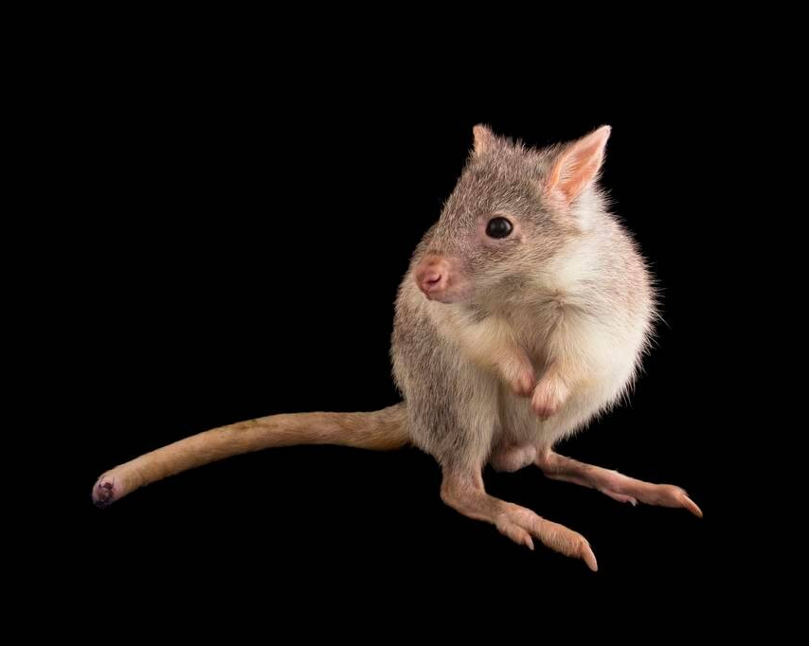
It is convergent evolution!
YES!
Kangaroo rat
Jerboa
Found in North America
Found in north Africa and West Asia
Bonus: There is also the convergently evolved rat-kangaroo,
an actual marsupial from Australia.

Slide 32
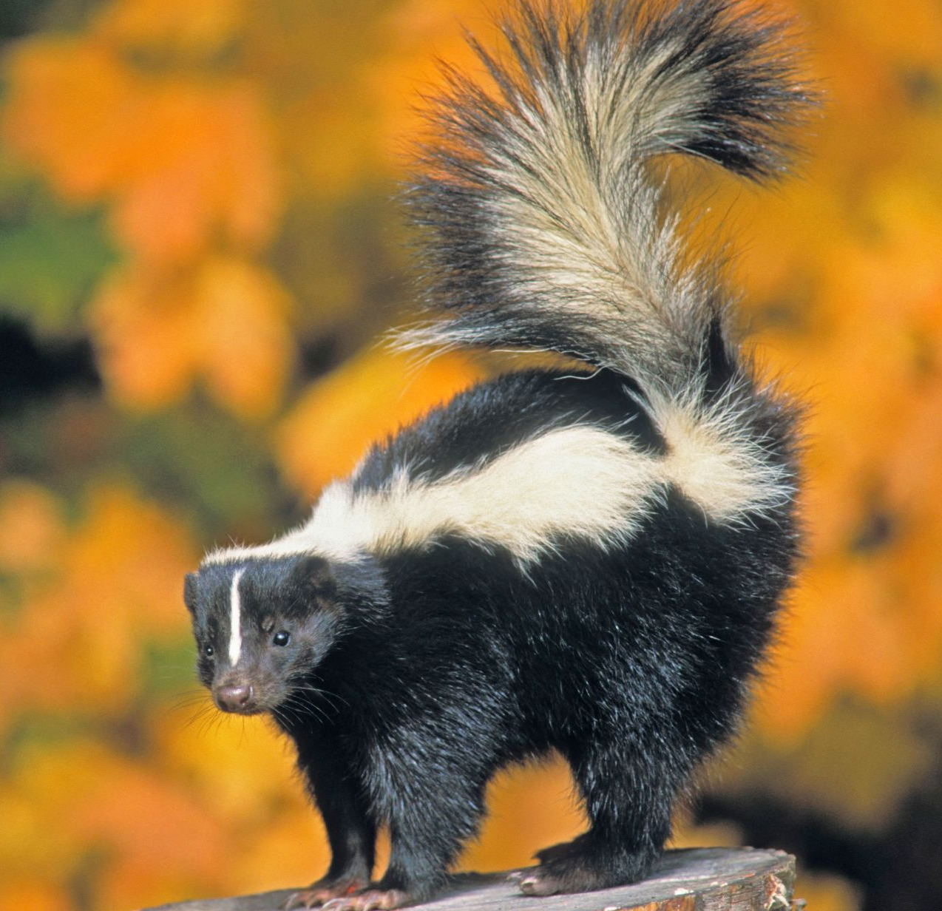
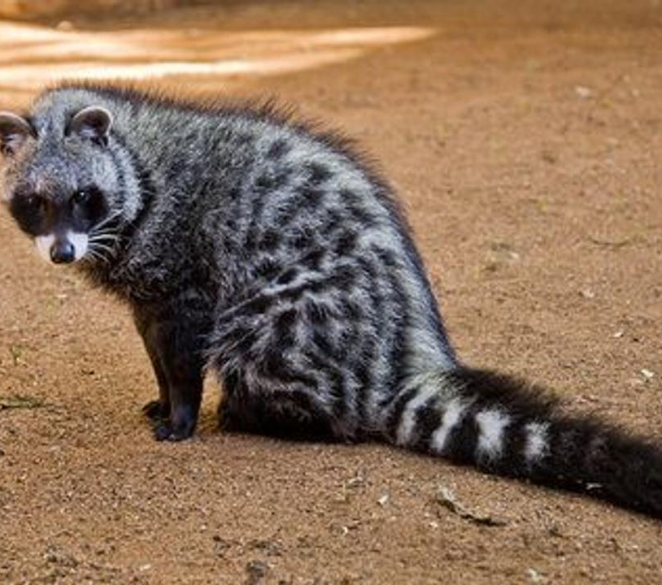
Which is a case for convergence?
A
B
C

Slide 33
Which is a case for convergence?
African Civet
(It is closely related to cats)
✅
Racoon
Skunk
CORRECT!
B
C
Both are closely related to dogs.
A
Next Q

Slide 34
Which is a case for convergence?
A
B
C
Go Back

Slide 35
Which is a case for convergence?
A
B
C
Go Back

Slide 36
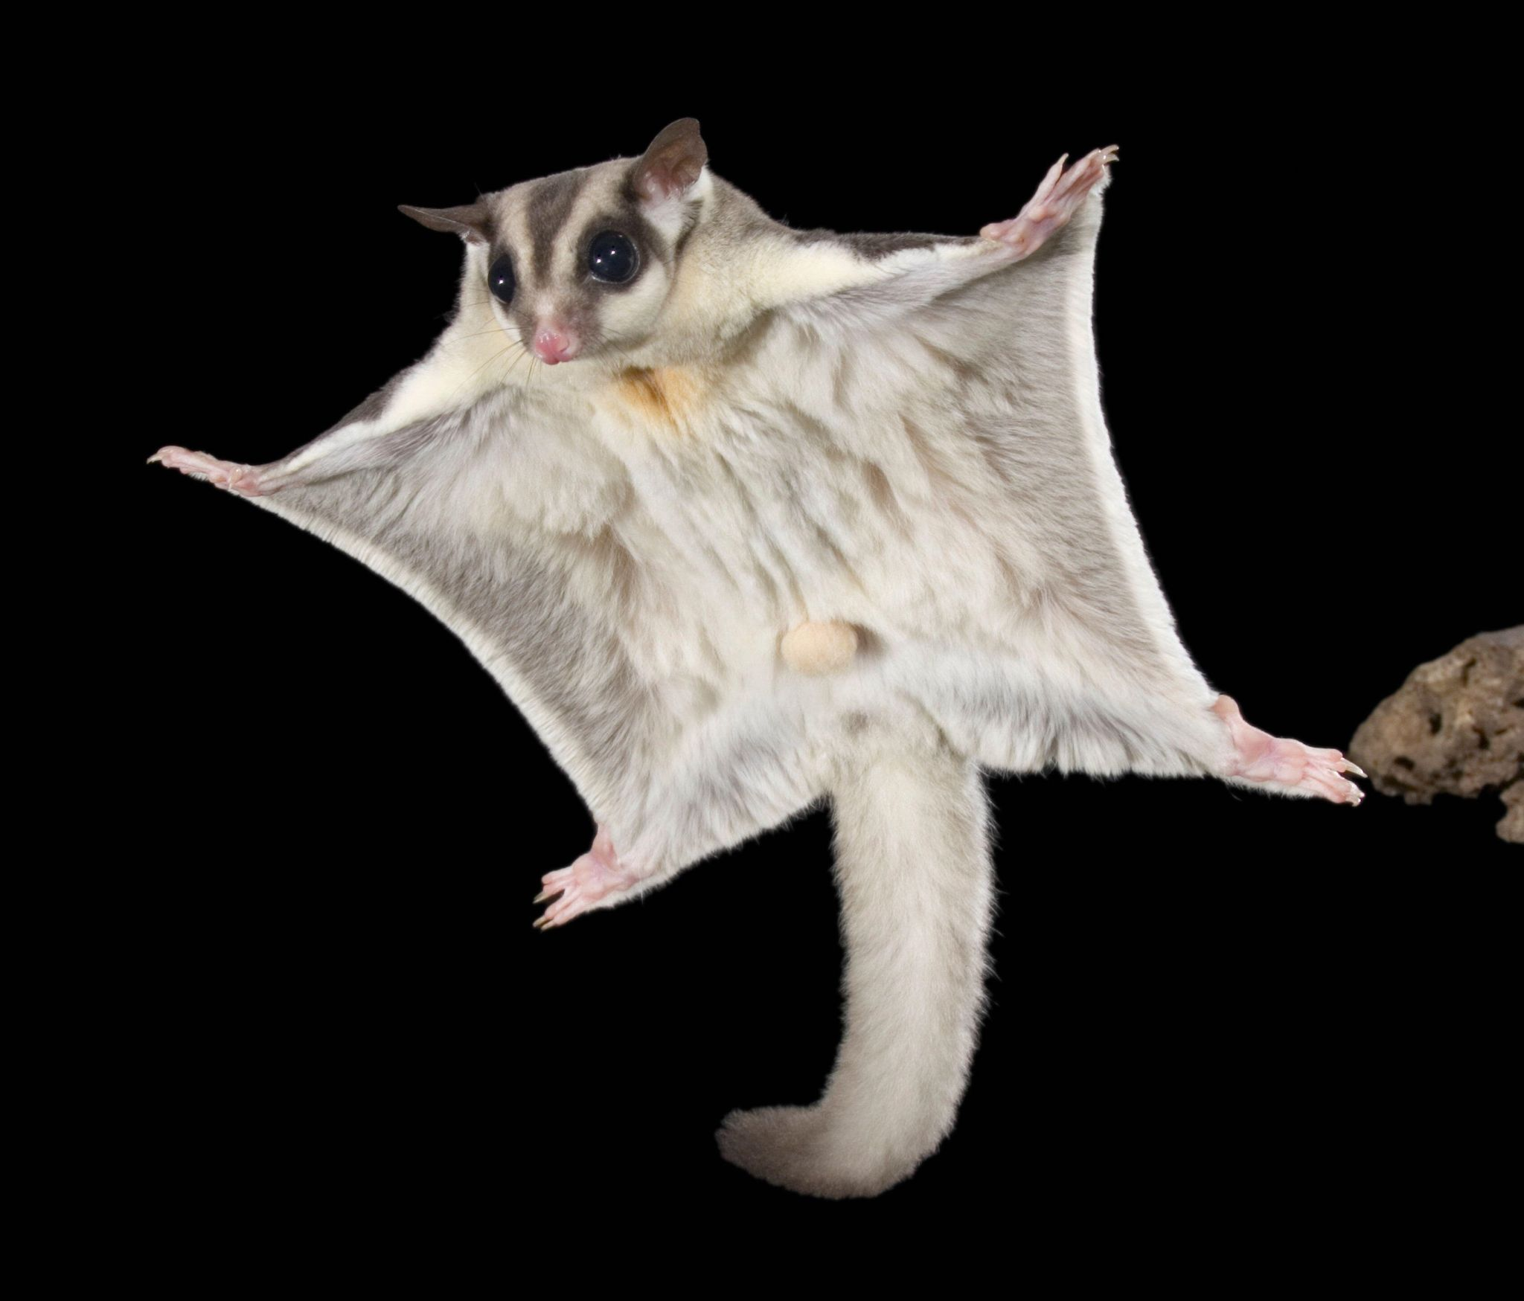
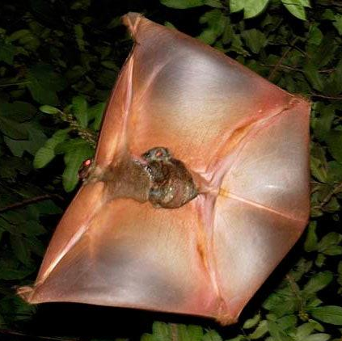
Is this a case of convergence?
YES
NO
Found in Australasia,
New Guinea
Found in Philippines, Indonesia

Slide 37
It is convergent evolution!
YES!
Colugo
Sugar glider
It is a marsupial.
Its closest relatives are primates.
Found in Australasia,
New Guinea
Found in Philippines, Indonesia

Slide 38
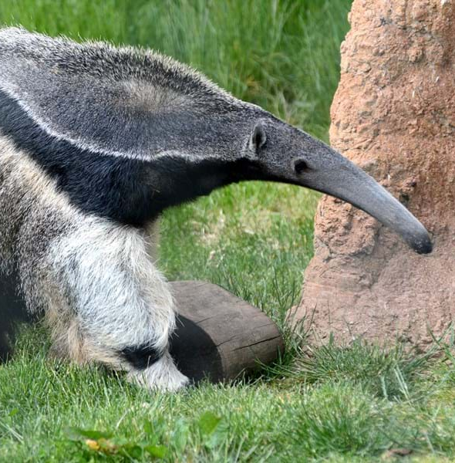
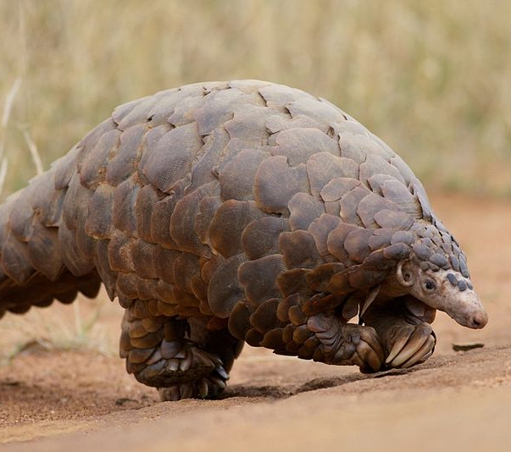
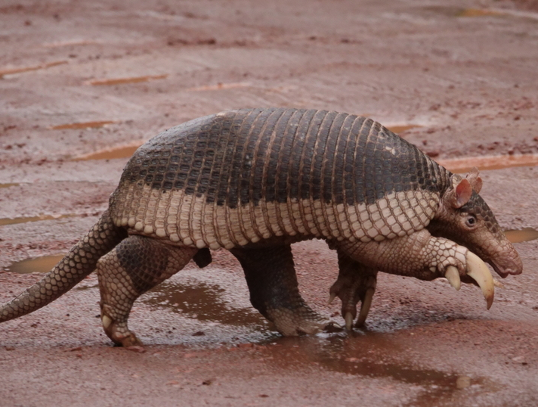
Which is a case for convergence?
A
B
C

Slide 39
Which is a case for convergence?
Giant Anteater
Giant Pangolin
(It is related to carnivorans)
Giant Armadillo
CORRECT!
A
B
Both are closely related, and related to sloths.
Next Q
C

Slide 40
Which is a case for convergence?
A
B
C
Go Back

Slide 41
Which is a case for convergence?
A
B
C
Go Back

Slide 42
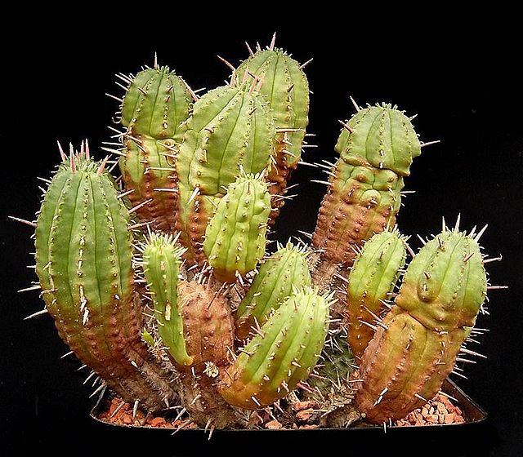

Is this a case of convergence?
Bonus: Which is the cactus?
YES
NO
Found in southern Africa
Found in North America

Slide 43
It is convergent evolution!
Euphorbia aggregata
Fairy castle cactus
YES!
Found in southern Africa
Found in North America

Slide 44
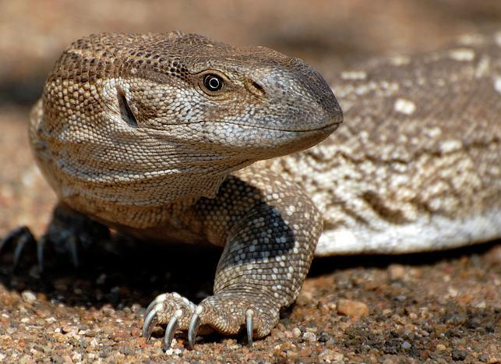
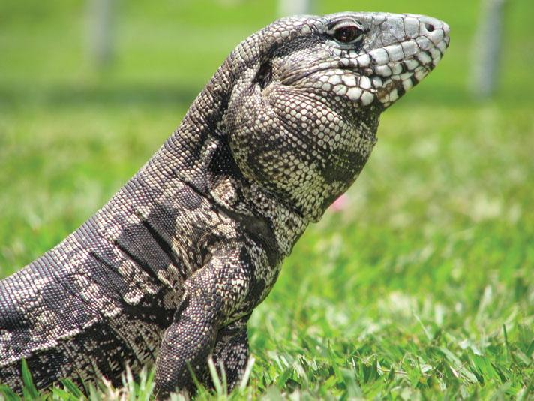
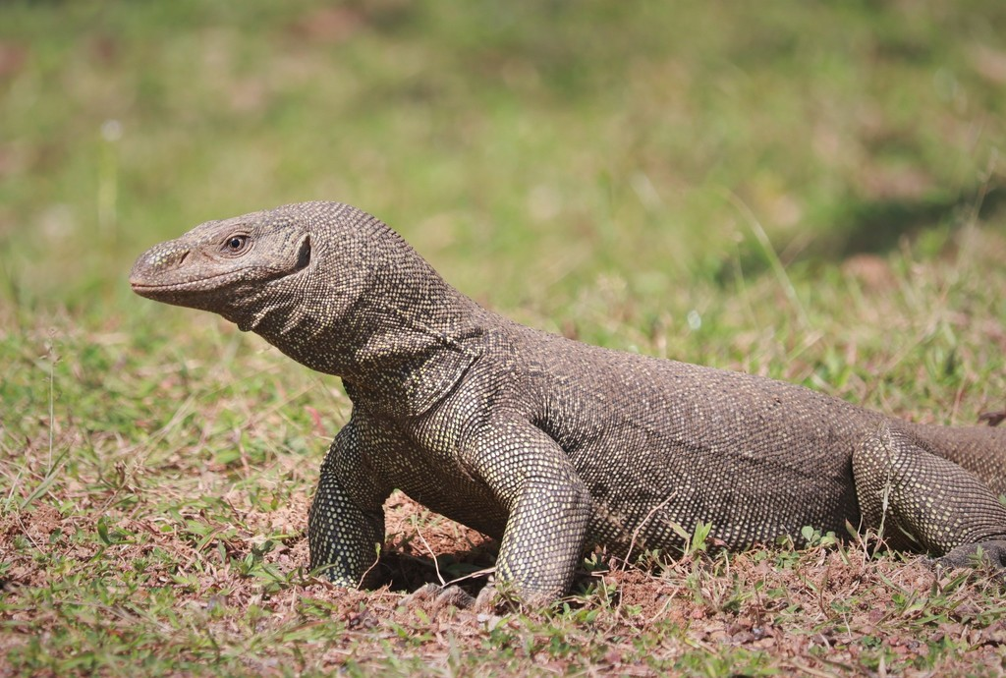
Which is a case for convergence?
A
B
C

Slide 45
Which is a case for convergence?
Rock Monitor lizard
Tegu
(found in the Americas, carnivorous)
Bengal Monitor lizard
CORRECT!
A
C
Africa
Asia
B
Next Q

Slide 46
Which is a case for convergence?
A
B
C
Go Back

Slide 47
Which is a case for convergence?
A
B
C
Go Back

Slide 48
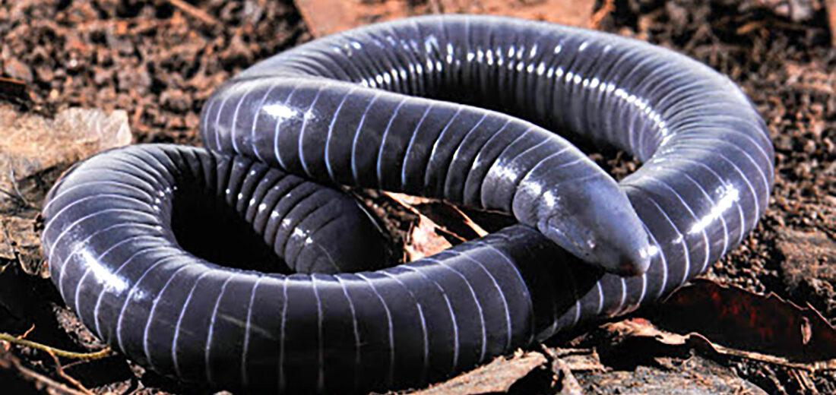
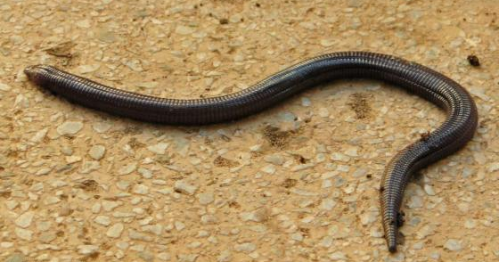
Is this a case of convergence?
Bonus: Which is more closely related to snakes?
Caecilia subnigricans
Amphisbaena ridleyi
YES
NO
Found in central America
Found in Brazil

Slide 49
It is convergent evolution!
All amphisbaenids have a collapsed right lung,
while in snakes, it is always the left.
YES!
Caecilia subnigricans
Amphisbaena ridleyi
This is a legless lizard.
It is an amphibian.
Found in central America
Found in Brazil

Slide 50
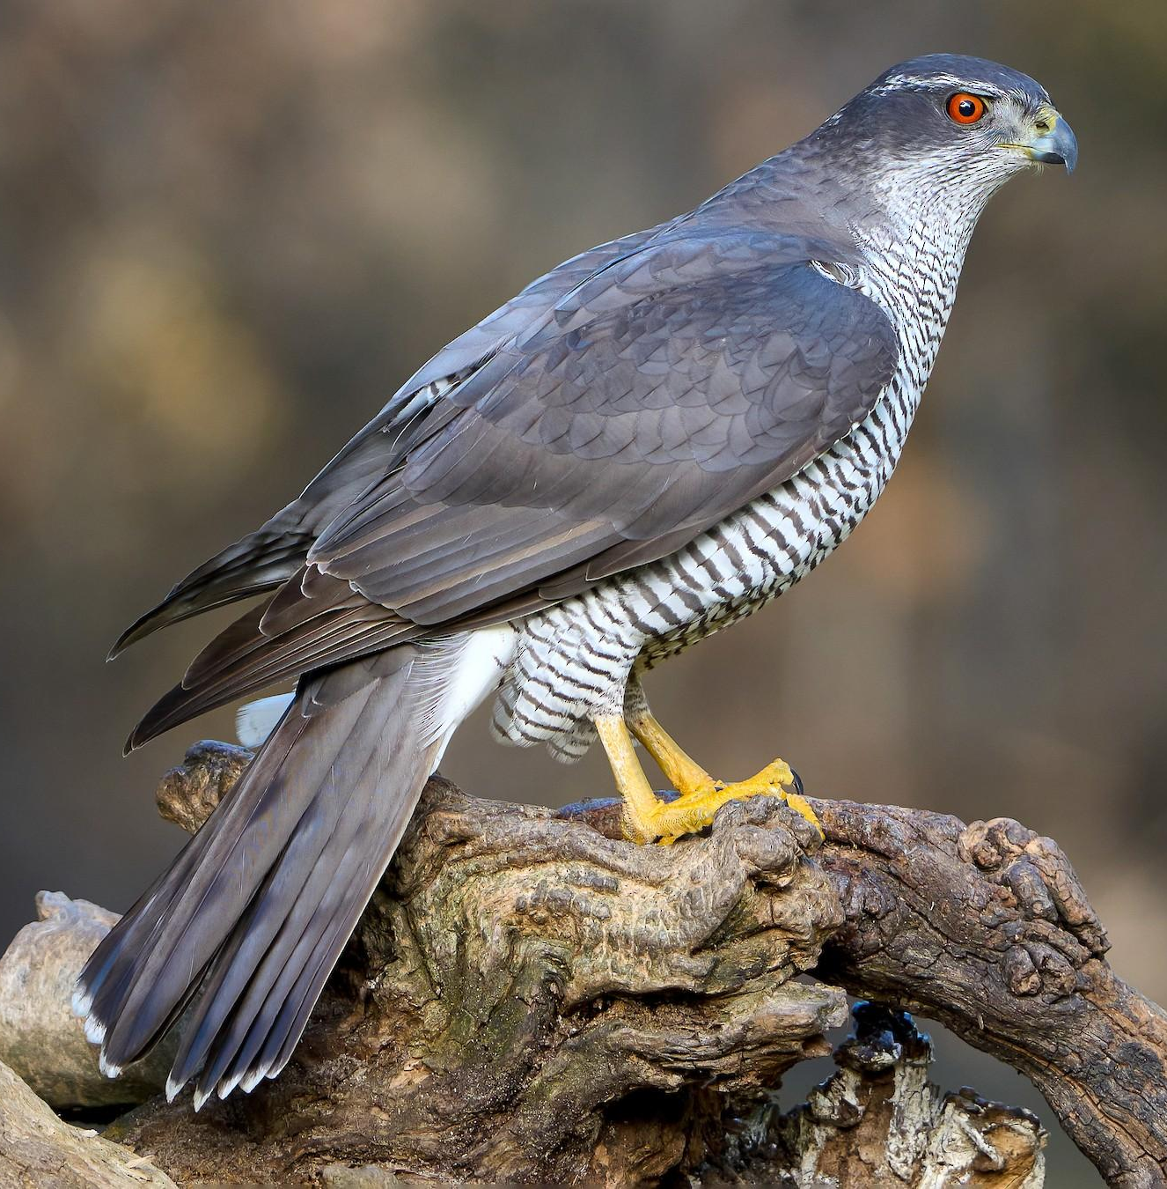
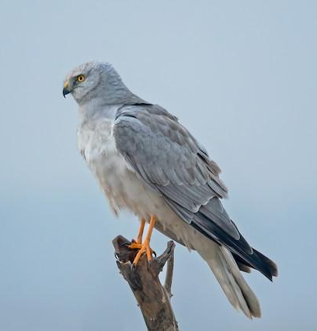
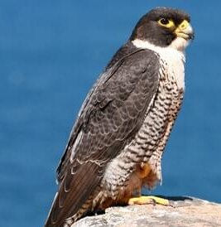
Which is a case for convergence?
Goshawk
Harrier
Falcon
A
B
C

Slide 51
Which is a case for convergence?
Goshawk
Harrier
Falcon
(closely related to parrots)
CORRECT!
A
B
Closely related to each other, along with eagles, buzzards, hawks, vultures, and kites.
Next Q
C

Slide 52
Which is a case for convergence?
Goshawk
Harrier
Falcon
A
B
C
Go Back

Slide 53
Which is a case for convergence?
Goshawk
Harrier
Falcon
A
B
C
Go Back

Slide 54
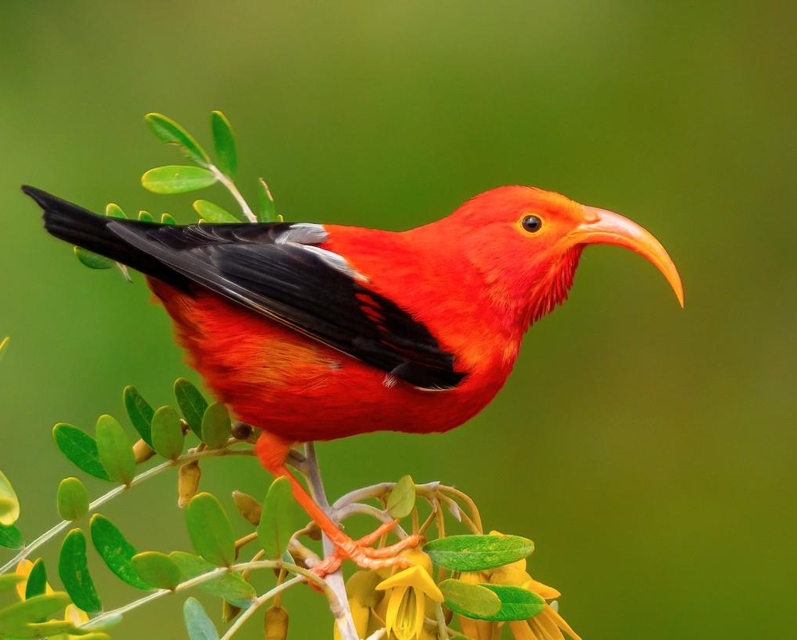
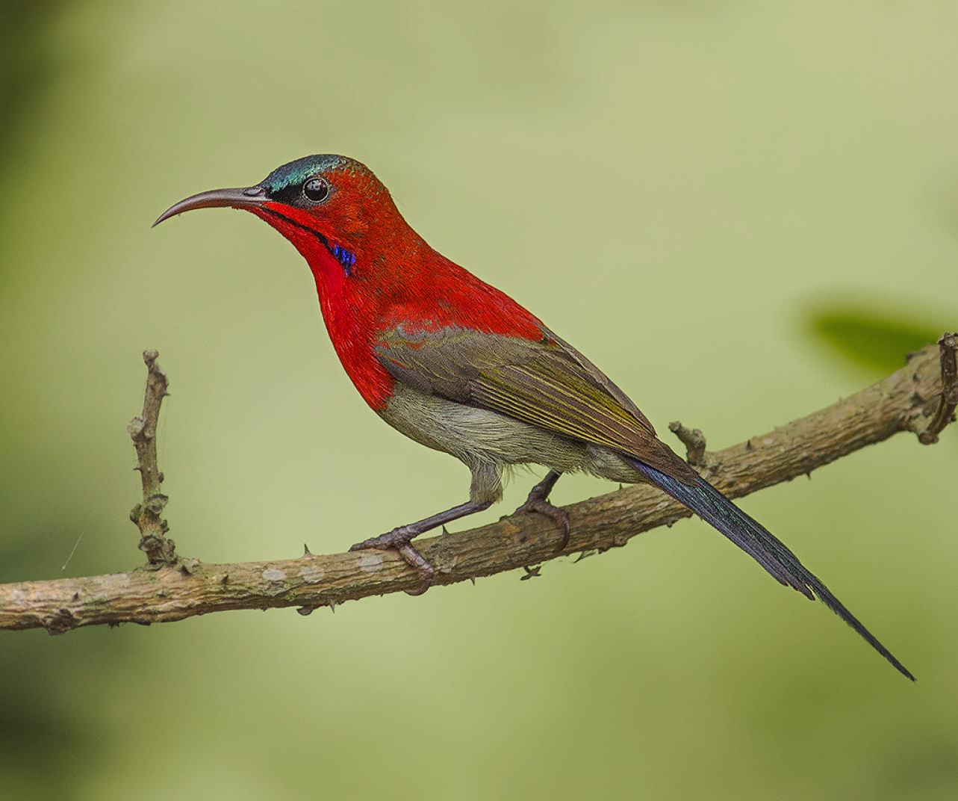
Is this a case of convergence?
Bonus: Which is more closely related to a finch?
YES
NO
Found in Hawaii
Found in Asia

Slide 55
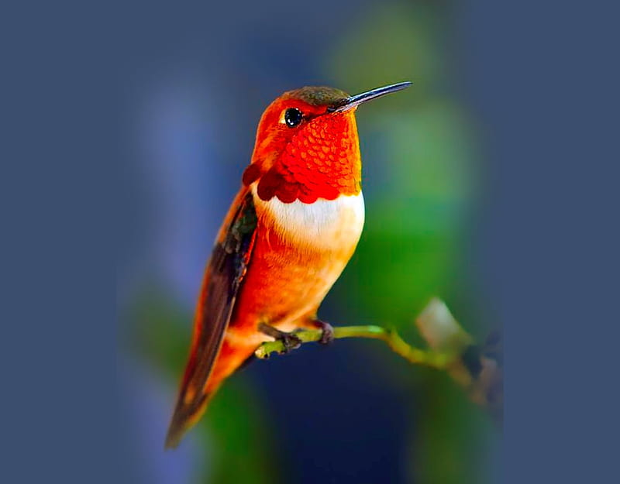
It is convergent evolution!
YES!
Hawaiin honeycreeper
Crimson sunbird
Rufous hummingbird
Found in Hawaii
Found in Asia
Bonus: Both of these are nectar feeders,
convergently evolved with the American hummingbirds.

Slide 56
Fin

